Slide 1

Title
DEPARTMENT OF ARTIFICIAL INTELLIGENCE AND DATA SCIENCE
Presented by
Divya Lakshmi D
2116241801060

Slide 2
TITLE OF THE INTERNSHIP
REGISTRATION NUMBER | : | 2116241801060
STUDENT NAME | : | Divya Lakshmi D
YEAR / SEMESTER | : | 2nd Year | 4th Semester
NAME OF THE ORGANIZATION / COMPANY | : | Labmentix
ORGANIZATION ADDRESS | : | 2nd Floor, UMIYA Emporium, Opposite to Nexus Mall, Tavarekere, Kaveri Layout, Koramangala, Bengaluru, Karnataka 560030
ONLINE / OFFLINE | : | Online
TRAINER NAME | : | Vipul Sonawanae
TRAINER’S CONTACT NO. | : | -
INTERNSHIP PERIOD | : | FROM : 15.12.2025 TO: 01.02.2026
INTERNSHIP DURATION | : | 45 DAYS

Slide 3
About the Training
During the 45-day online internship at LabMentix, I gained practical exposure to data science concepts and basic machine learning techniques. The training focused on data preprocessing, Exploratory Data Analysis (EDA), and data visualization using Python libraries such as Pandas, NumPy, Matplotlib, and Seaborn. I worked on real-world datasets including streaming platforms, mental health surveys, and e-commerce transactions to understand data patterns and trends. Additionally, I applied basic machine learning concepts such as RFM analysis and K-Means clustering for customer segmentation. This internship helped in enhancing my analytical thinking, problem-solving skills, and ability to derive meaningful insights to support data-driven decision-making.

Slide 4
Abstract / Executive Summary
This internship focused on applying data science techniques to analyze real-world datasets and derive meaningful insights for decision-making. The work involved data preprocessing, Exploratory Data Analysis (EDA), and data visualization using Python-based tools. Multiple projects were carried out across different domains, including content analysis of streaming platforms, mental health survey analysis, and e-commerce customer behavior analysis.
The e-commerce project further incorporated basic machine learning techniques such as RFM (Recency, Frequency, Monetary) analysis and K-Means clustering to segment customers based on their purchasing patterns. The results highlighted that a small group of customers contributes significantly to overall revenue, while many customers show low engagement or are at risk of churn.
Overall, the internship demonstrated how data-driven approaches can be used to understand patterns, support business strategies, and improve decision-making. It also helped in developing practical skills in data handling, visualization, and analytical thinking through hands-on project experience.

Slide 5
Introduction
The rapid growth of data in today’s digital world has made data science an essential tool for extracting meaningful insights and supporting decision-making. This project focuses on applying data science techniques such as data preprocessing, Exploratory Data Analysis (EDA), and basic machine learning to analyze real-world datasets from different domains.
The work includes analysis of streaming platform content, mental health survey data, and e-commerce transactions to understand patterns, trends, and user behavior. Various visualization techniques were used to represent data effectively, while customer segmentation using RFM analysis and K-Means clustering was applied to identify different customer groups.
This project demonstrates how data-driven approaches can help organizations improve strategies, enhance user understanding, and make informed business decisions.

Slide 6
Objectives of the Internship
The primary objective of the internship was to gain practical knowledge in data science by working with real-world datasets and applying analytical techniques. The internship focused on understanding data preprocessing, Exploratory Data Analysis (EDA), and data visualization to extract meaningful insights from data.
Another key objective was to develop basic knowledge of machine learning concepts, particularly customer segmentation using RFM (Recency, Frequency, Monetary) analysis and K-Means clustering. The internship also aimed to enhance problem-solving skills, analytical thinking, and the ability to interpret data for supporting business decision-making.
Overall, the internship was designed to provide hands-on experience in the complete data analysis workflow, from data cleaning to insight generation, and to bridge the gap between theoretical learning and practical application.

Slide 7
Brief Description of Work / Project
During the internship, multiple data science projects were carried out using real-world datasets from different domains. The work mainly involved data preprocessing, Exploratory Data Analysis (EDA), and data visualization to understand patterns and trends. Projects included analyzing streaming platform content to study distribution and ratings, examining mental health survey data to understand workplace factors, and analyzing e-commerce transactions to study customer behavior.
In the advanced project, RFM (Recency, Frequency, Monetary) analysis and K-Means clustering were applied to segment customers into different groups such as high-value and at-risk customers. Overall, the work focused on deriving meaningful insights from data and applying basic machine learning techniques to support data-driven decision-making.

Slide 8
Learning Outcome
Through this project, I gained a strong understanding of data science concepts, particularly in data preprocessing, Exploratory Data Analysis (EDA), and data visualization. I developed the ability to work with real-world datasets, clean and transform data, and extract meaningful insights using Python libraries.
I also acquired basic knowledge of machine learning techniques, especially customer segmentation using RFM analysis and K-Means clustering. The project helped improve my analytical thinking, problem-solving skills, and ability to interpret data for business decision-making, while providing hands-on experience in the complete data analysis workflow.

Slide 9
Conclusion
This project successfully demonstrates the practical application of data science techniques in analyzing real-world datasets and deriving meaningful insights. By applying data preprocessing, Exploratory Data Analysis (EDA), and visualization methods, important patterns and trends were identified across different domains.
The implementation of RFM analysis and K-Means clustering in the e-commerce dataset further highlights how basic machine learning techniques can be used for customer segmentation and business decision-making. Overall, the project enhanced technical skills in Python and data handling while improving analytical thinking and problem-solving abilities, showing how data-driven approaches can support effective strategies and informed decisions.

Slide 10
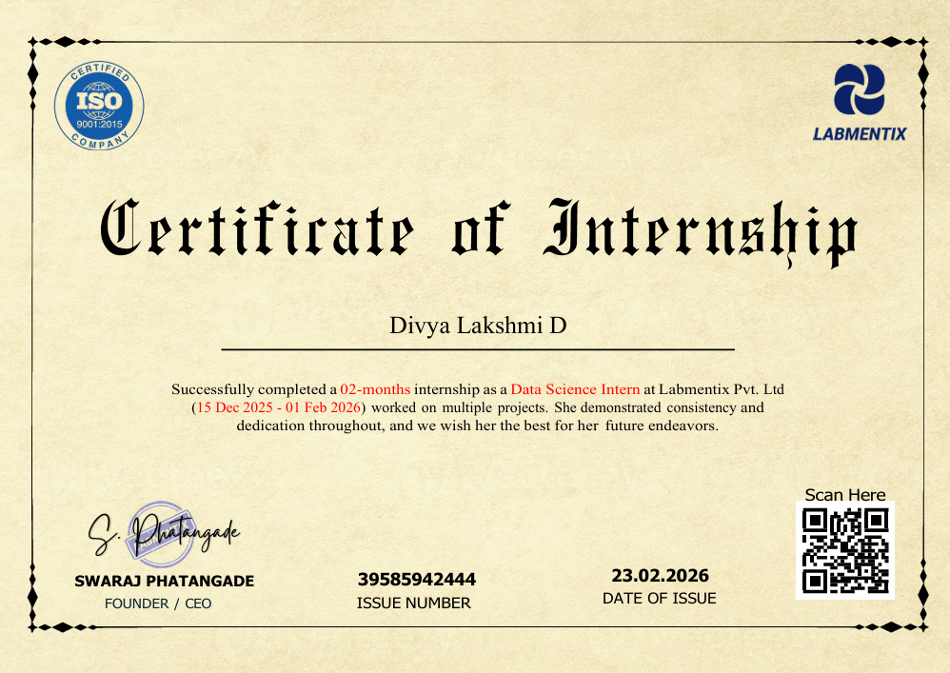
INTERNSHIP CERTIFICATE

Slide 11
Thank You

